Slide 1
DBMS PROJECT-BASED LEARNING • REVIEW 2
Car Rental Reservation &
Vehicle Return Management System
Database Implementation — Schema, Constraints, Queries & Live Prototype
Presented by: Koneri Mithul | Roll Number(s)-25WU0102129 | Class & Section-AIML PANTHERS
Guide: Dr. Kiran Mayee Adavala | Department of Computer Science
Notes:
State clearly: 'Review 1 was the design. Review 2 is the working database — a real MySQL implementation we've built and tested end-to-end.' That framing sets up the whole talk.

Slide 2
PROGRESS
From Design to a Working Database
Review 1 — Completed
Review 2 — New This Phase
✓ Problem statement, scope & objectives
✓ Schema normalized to 3NF, with proof
✓ Users & functional requirements
✓ Full MySQL DDL: PK/FK/CHECK/UNIQUE/triggers
✓ 60+ rows of realistic sample data
✓ ER diagram — 11 entities
✓ Joins, subqueries, aggregates & 6 views
✓ Initial relational schema
✓ Transactions (COMMIT/ROLLBACK) & indexing
✓ Live, tested database — zero errors
Car Rental Reservation & Vehicle Return Management System | Review 2
2
Notes:
This slide is the whole narrative in one glance — point at it and say 'everything on the right has been built and tested, not just planned.'

Slide 3
NORMALIZATION
1NF → 2NF → 3NF, With a Real Example
1NF
Every column atomic, no repeating groups
Vehicle has one make, one model, one status per row — no comma-separated lists.
2NF
Non-key attributes depend on the WHOLE key
All 11 tables use a single-column surrogate key, so 2NF holds automatically once 1NF does.
3NF
No attribute depends on another non-key attribute
Vehicle stores category_id only — NOT category_name. category_name depends on category_id, not on vehicle_id, so it stays in VehicleCategory.
Car Rental Reservation & Vehicle Return Management System | Review 2
4
Notes:
The Vehicle/category_name example on the 3NF row is the single most important line on this slide - if asked 'prove your database is in 3NF', this is the answer.

Slide 4
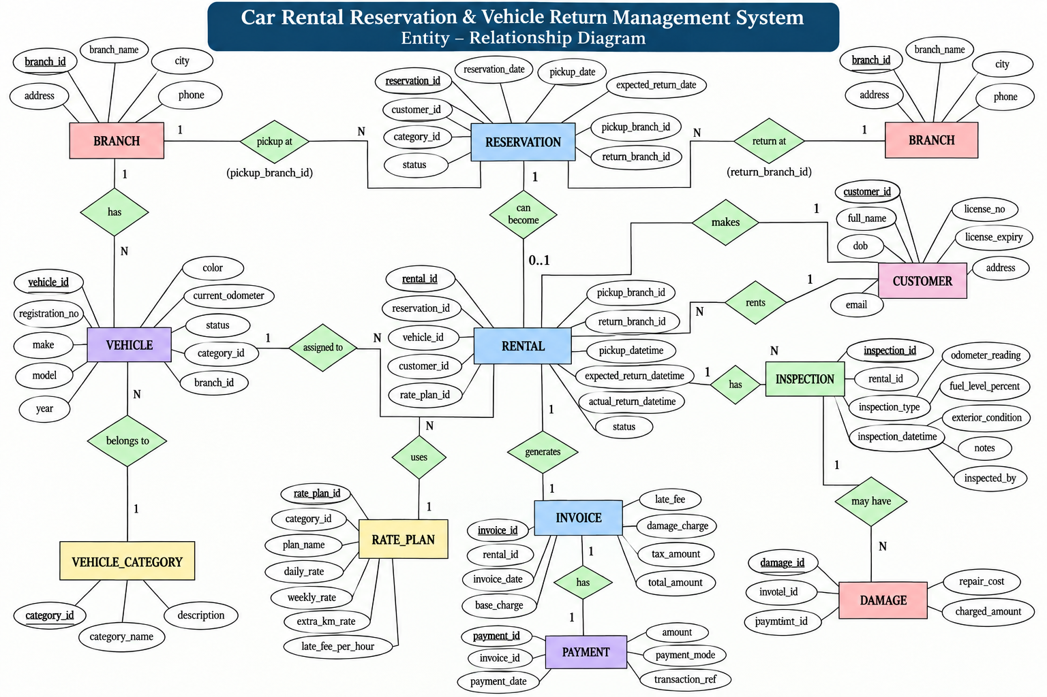

Slide 5
NORMALIZATION
Key Functional Dependencies
Vehicle: vehicle_id → registration_no, category_id, branch_id, make, model, status
Customer: customer_id → full_name, phone, email, license_no, license_expiry
Rental: rental_id → vehicle_id, customer_id, rate_plan_id, pickup_datetime, actual_return_datetime
Invoice: invoice_id → rental_id, base_charge, extra_km_charge, late_fee, total_amount
Payment: payment_id → invoice_id, amount, payment_mode, payment_date
Every determinant above is the WHOLE primary key, and everything it determines depends on it directly — never on another non-key column. That is 3NF, applied literally.
Car Rental Reservation & Vehicle Return Management System | Review 2
5
Notes:
Say the closing line on screen almost verbatim - it's the cleanest one-sentence tie-back from FDs to 3NF you have.

Slide 6
IMPLEMENTATION
Relational Schema — All 11 Tables
Branch(branch_id PK, branch_name, city, address, phone)
VehicleCategory(category_id PK, category_name UK, description)
Vehicle(vehicle_id PK, registration_no UK, category_id FK, branch_id FK, ..., status)
Customer(customer_id PK, phone UK, email UK, license_no UK, license_expiry, ...)
RatePlan(rate_plan_id PK, category_id FK, daily_rate, extra_km_rate, late_fee_per_hour)
Reservation(reservation_id PK, customer_id FK, category_id FK, pickup/return_branch_id FK, ...)
Rental(rental_id PK, reservation_id FK NULL, vehicle_id FK, customer_id FK, rate_plan_id FK, ...)
Inspection(inspection_id PK, rental_id FK, inspection_type, odometer_reading, fuel_level_percent)
Damage(damage_id PK, rental_id FK, inspection_id FK NULL, repair_cost, charged_amount)
Invoice(invoice_id PK, rental_id FK UK, base_charge, extra_km_charge, late_fee, total_amount)
Payment(payment_id PK, invoice_id FK, amount, payment_mode, transaction_ref)
Car Rental Reservation & Vehicle Return Management System | Review 2
6
Notes:
This is now the LIVE, executed schema, not a draft - every line here exists in a real database you can query on the spot.

Slide 7
DOCUMENTATION
Data Dictionary — Rental (Representative)
Column
Type
Key
Null
Default
Notes
rental_id
INT
PK
NOT NULL
AUTO_INC
reservation_id
INT
FK
NULL
Nullable — walk-ins
vehicle_id
INT
FK
NOT NULL
customer_id
INT
FK
NOT NULL
rate_plan_id
INT
FK
NOT NULL
pickup_datetime
DATETIME
NOT NULL
actual_return_datetime
DATETIME
NULL
CHECK > pickup
status
VARCHAR(15)
NOT NULL
'Active'
CHECK IN (...)
Full data dictionary for all 11 tables is in the project report — shown here is one representative table.
Car Rental Reservation & Vehicle Return Management System | Review 2
7
Notes:
If asked about another table's dictionary, say 'same format, in the report' and move on - don't try to recite all 11 from memory.

Slide 8
IMPLEMENTATION
DDL & Integrity Constraints
PRIMARY KEY
Every table — AUTO_INCREMENT surrogate key
FOREIGN KEY
Every relationship, with explicit ON DELETE/UPDATE
UNIQUE
registration_no, phone, email, license_no, Invoice.rental_id
CHECK
Value ranges: year, odometer ≥ 0, fuel 0–100%, charges ≥ 0, date ordering
NOT NULL / DEFAULT
Required fields; status defaults ('Available', 'Active', 'Booked')
TRIGGER
5 triggers — cross-row rules + automatic vehicle status sync
Car Rental Reservation & Vehicle Return Management System | Review 2
8
Notes:
Each of these six rows corresponds to a real line you can point to in the SQL file if asked to show it live.

Slide 9
IMPLEMENTATION
Realistic Sample Data Loaded
4
4
12
9
5
10
Branches
Categories
Vehicles
Customers
Rate Plans
Reservations
9
17
3
7
8
Rentals
Inspections
Damages
Invoices
Payments
Deliberately includes: available / rented / maintenance vehicles • an active rental • an overdue rental • a rental with damage • an invoice paid in two partial installments
Car Rental Reservation & Vehicle Return Management System | Review 2
9
Notes:
Emphasize the variety, not just the volume - the panel wants to see edge cases covered (overdue, damage, partial payment), not just row counts.

Slide 10
QUERYING THE DATABASE
Queries, Subqueries, Aggregation & Views
Joins
Customer rental history, Invoice+Payment, Damage+Vehicle+Customer
Subqueries
Customers/vehicles above-average rental count, branches above-average revenue
Aggregation
COUNT/SUM/AVG/MIN/MAX with GROUP BY — revenue, utilization, damage cost
Views (6)
Fleet Availability, Overdue Rentals, Customer History, Branch Revenue, Utilization, Damage Report
Car Rental Reservation & Vehicle Return Management System | Review 2
10
Notes:
The 6 views map exactly to the 6 required reports from the brief - say that connection out loud.

Slide 11
DATA INTEGRITY
Business Rules — Tested & Confirmed
No overlapping rentals
Trigger
✓ Confirmed: rejected with overlap error
Valid driving licence
Trigger
✓ Confirmed: rejected with expiry error
Return after pickup
CHECK
✓ Confirmed: rejected by CHECK constraint
Valid odometer / fuel
CHECK + Trigger
✓ Confirmed: rejected with odometer error
Non-negative charges
CHECK
✓ Confirmed: rejected by CHECK constraint
Car Rental Reservation & Vehicle Return Management System | Review 2
11
Notes:
Say explicitly: 'every one of these was actually tested against a running MySQL instance, not just written and assumed to work.' That single claim differentiates a strong Review 2 from an average one.

Slide 12
Live Database Prototype
Demo flow: Customer → Reservation → Rental → Inspection → Damage → Invoice → Payment
Tables, keys & relationships (DESCRIBE / SHOW)
INSERT, SELECT, JOIN, subquery, view — live
Constraint & trigger rejections — shown failing on purpose
Transaction COMMIT and ROLLBACK, verified after each
Achieved: a normalized, constraint-enforced, tested MySQL database ready for the Review 3 application layer.
Thank You — Questions & Discussion
Notes:
Close strong: name the achievement in one sentence (on screen) before opening the floor. Keep the rules table from slide 11 fresh in memory for Q&A.

